Slide 1

Innovation for the Long Term: How do You Continue Innovation Over the Long Term?
How do You Understand and Adjust to the Changing Market Landscape?
  Arthur E. (Ned) Uber, III Ph.D
  SAGES course #47
  August 13, 2020
  ned.uber@bayer.com
  Slides use builds

Slide 2



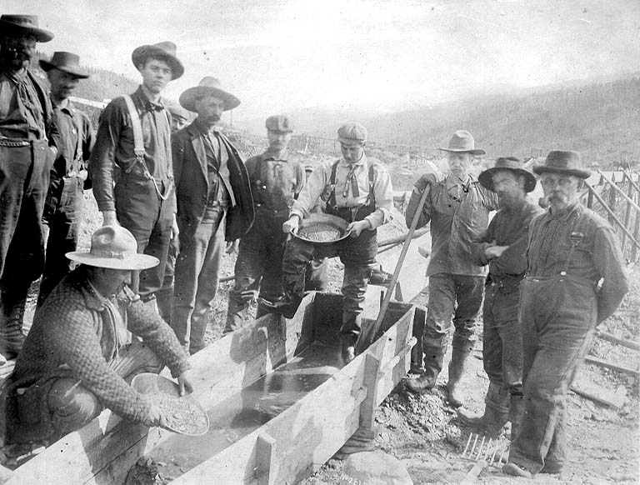
Arthur E (Ned) Uber, III
Employee of Bayer, AG
No other disclosures.

Slide 3
Arthur E (Ned) Uber, III
Introduction
  37+ years with MEDRAD, Schering AG, and now Bayer
  > 100 US patents
  Ph.D. in Electrical Engineering with additional background in biomedical engineering, physics, mechanical engineering, … .
  Know enough about many disciplines to be dangerous … and creative. (The Medici Effect)
  I hope to be inventing for at least 20 more years!
  Played a role in several startups. All are gone.
  Contributed to MEDRAD’s TQM journey & MBNQA award winnings.
  Team Training & Facilitation
  Ethnography
  Apply Research/Learning/Teaching skills to business, too.

Slide 4
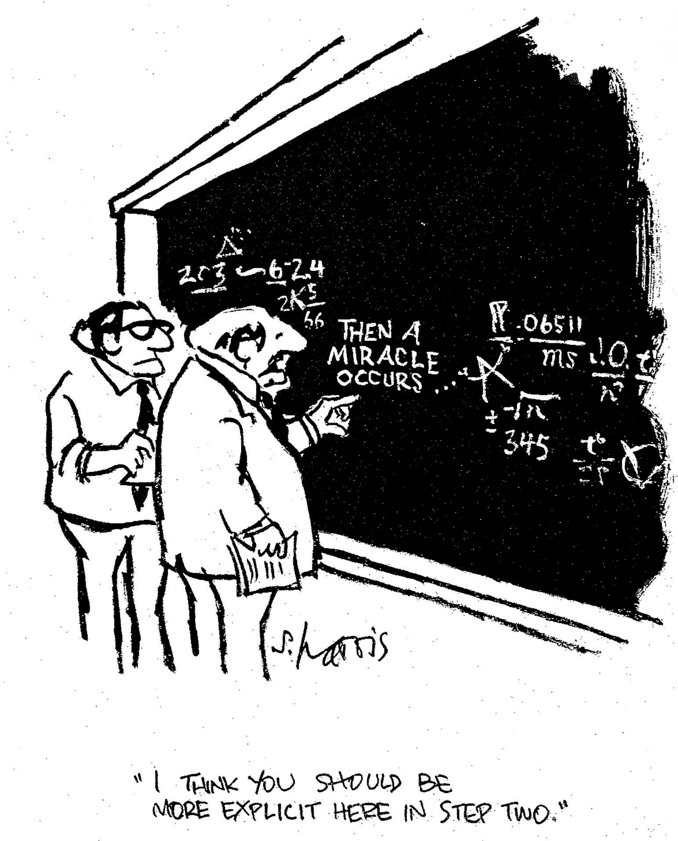
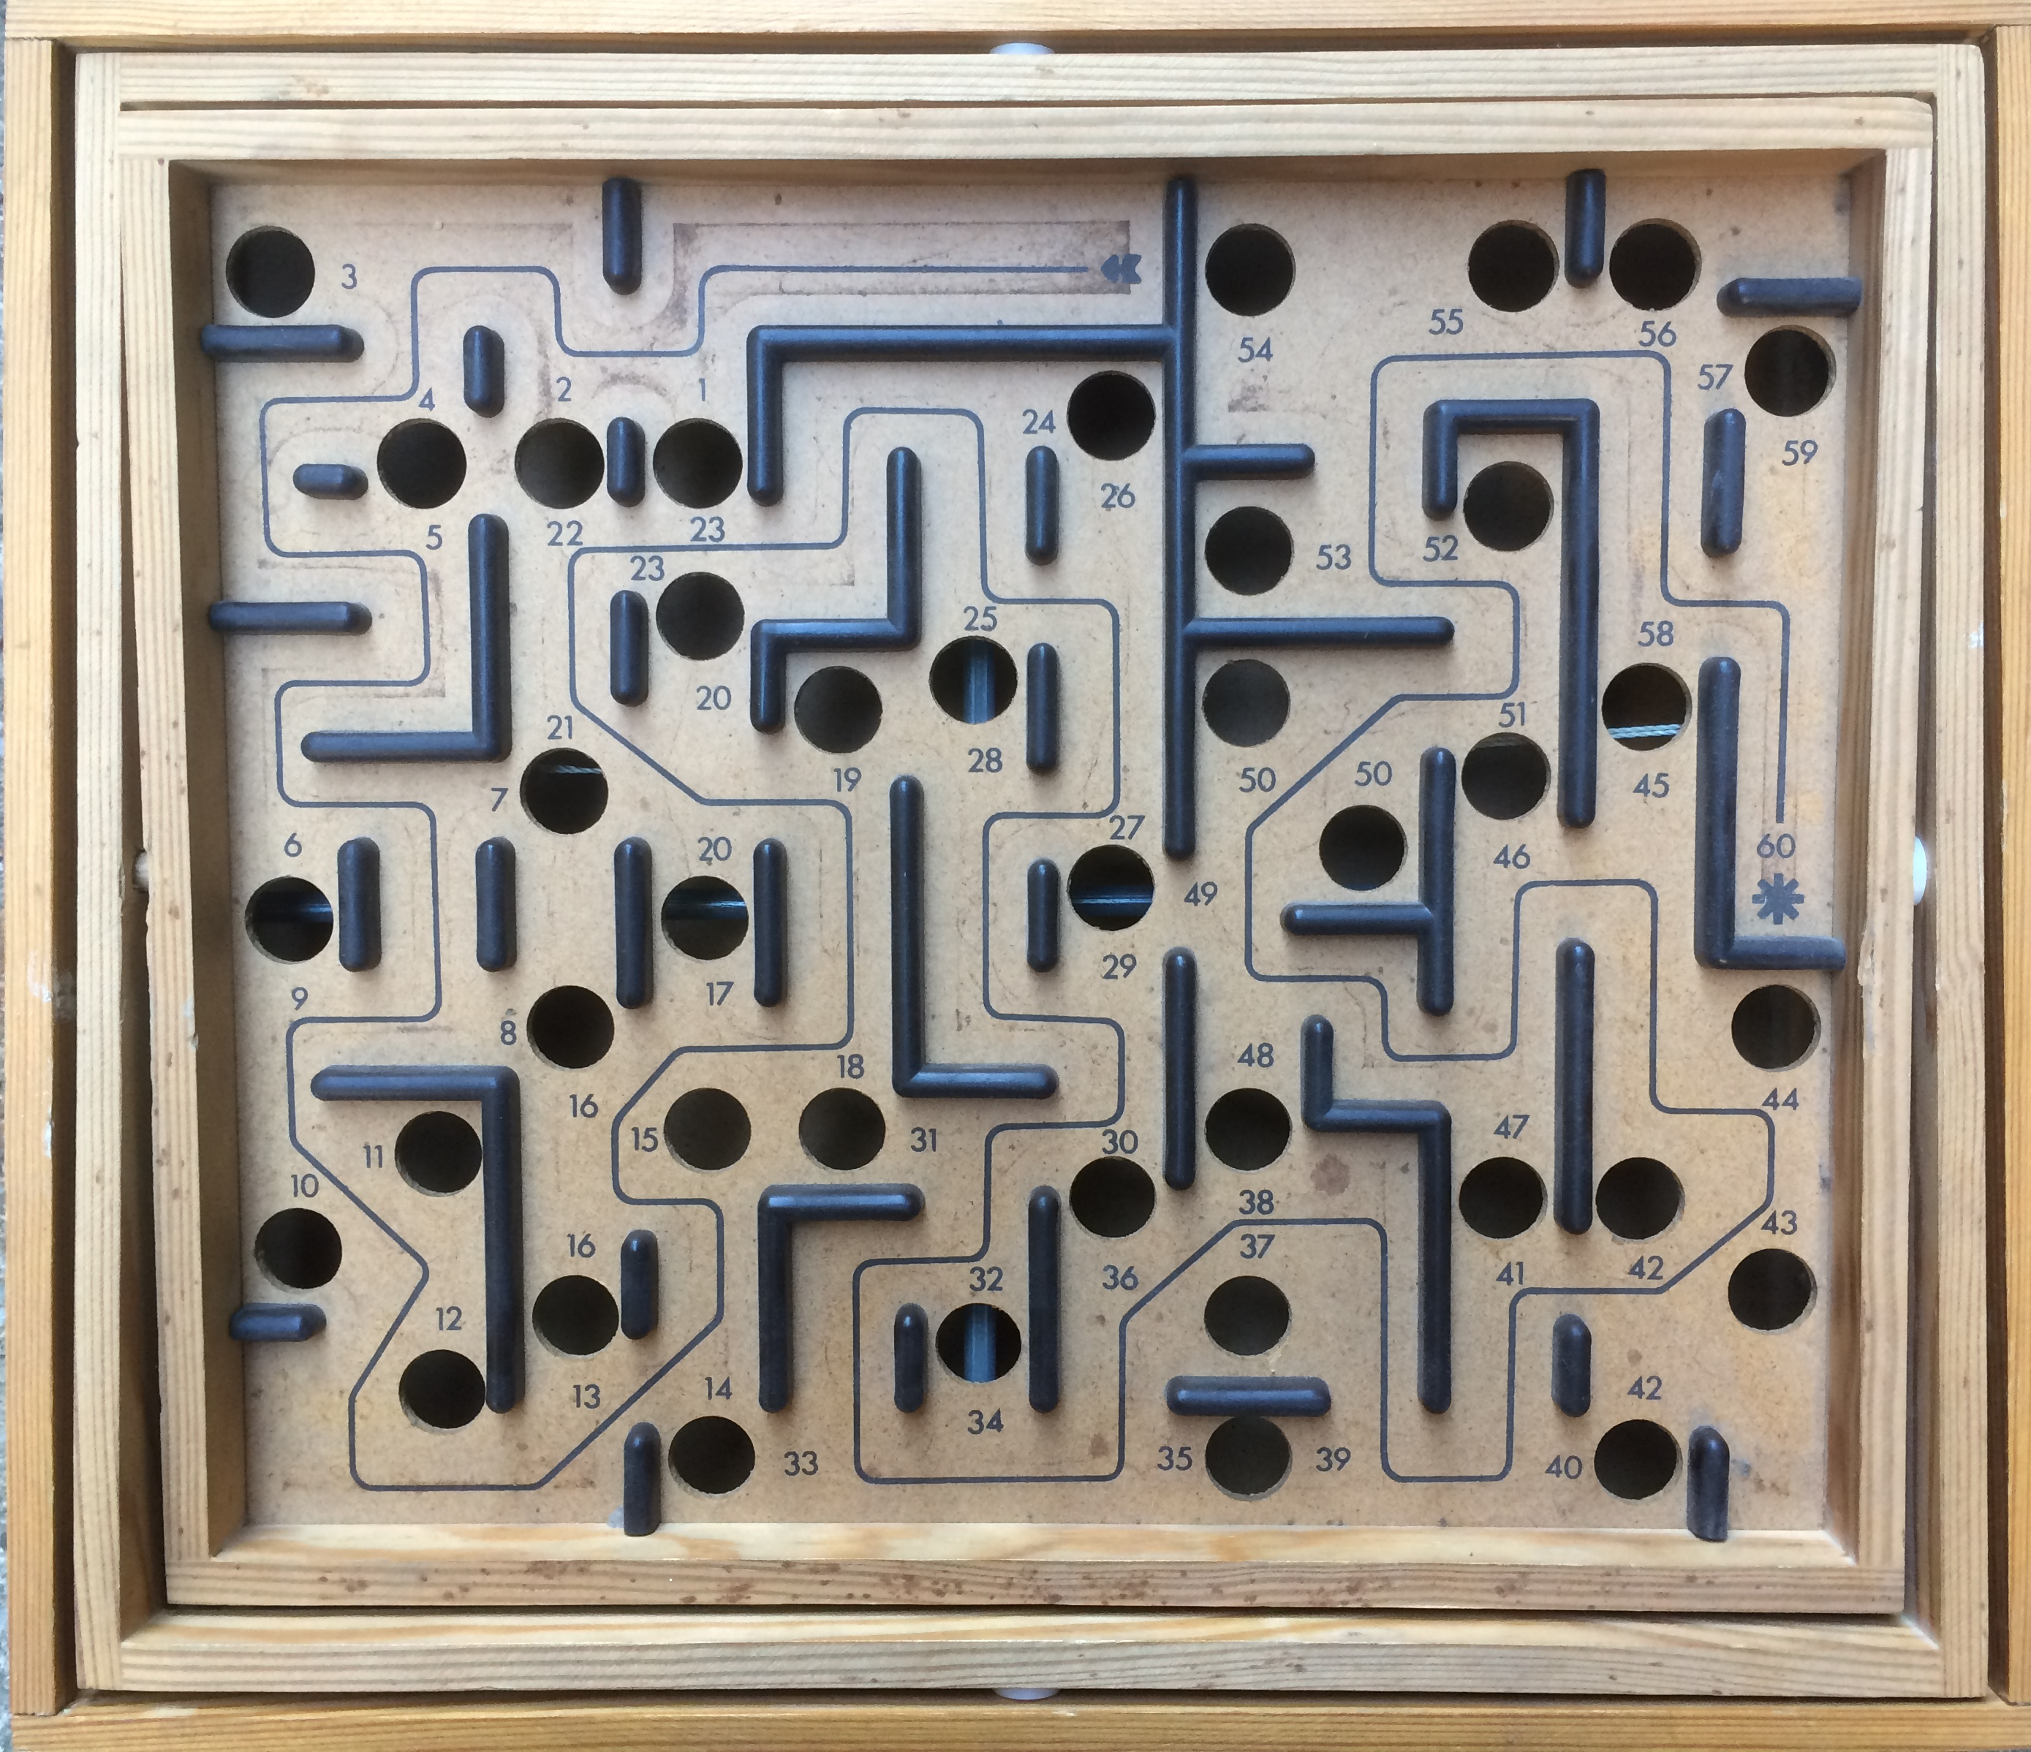

How do You Continue Innovation Over the Long Term?
Definitions
Invention – finding a solution to a problem
Innovation – bringing the solution to market in a sustainable way

Slide 5

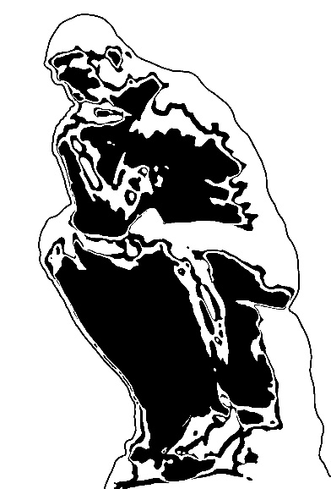
How do You Continue Innovation Over the Long Term?
A Universe of Unmet or
Poorly Met Needs
A Universe of
Existing or
New Technologies
Many roles.
Invention – finding a solution to a problem
To invent you need a good imagination and a pile of junk. Thomas Edison
Accepted Disharmony.
The Ah-ha,
The Match

Slide 6
How do You Continue Innovation Over the Long Term?
Invention – finding a solution to a problem
Innovation – bringing the solution to market in a sustainable way
Easy to answer. Hard to do.
Answer - Continue to participate, explore, work at the edges of what is known and what is possible.
Chance favors only the prepared mind, Louis Pasteur
Notice your accepted disharmonies - The eye is only able to see what the mind is prepared to comprehend. Henri Bergson
Grow you Edison’s junk pile - To invent you need a good imagination and a pile of junk. Thomas Edison
Step up in your systems perspective - Ecosystems Innovate & the Innovator’s Dilemma
Be patient and persistent - Water wears away rock every time

Slide 7
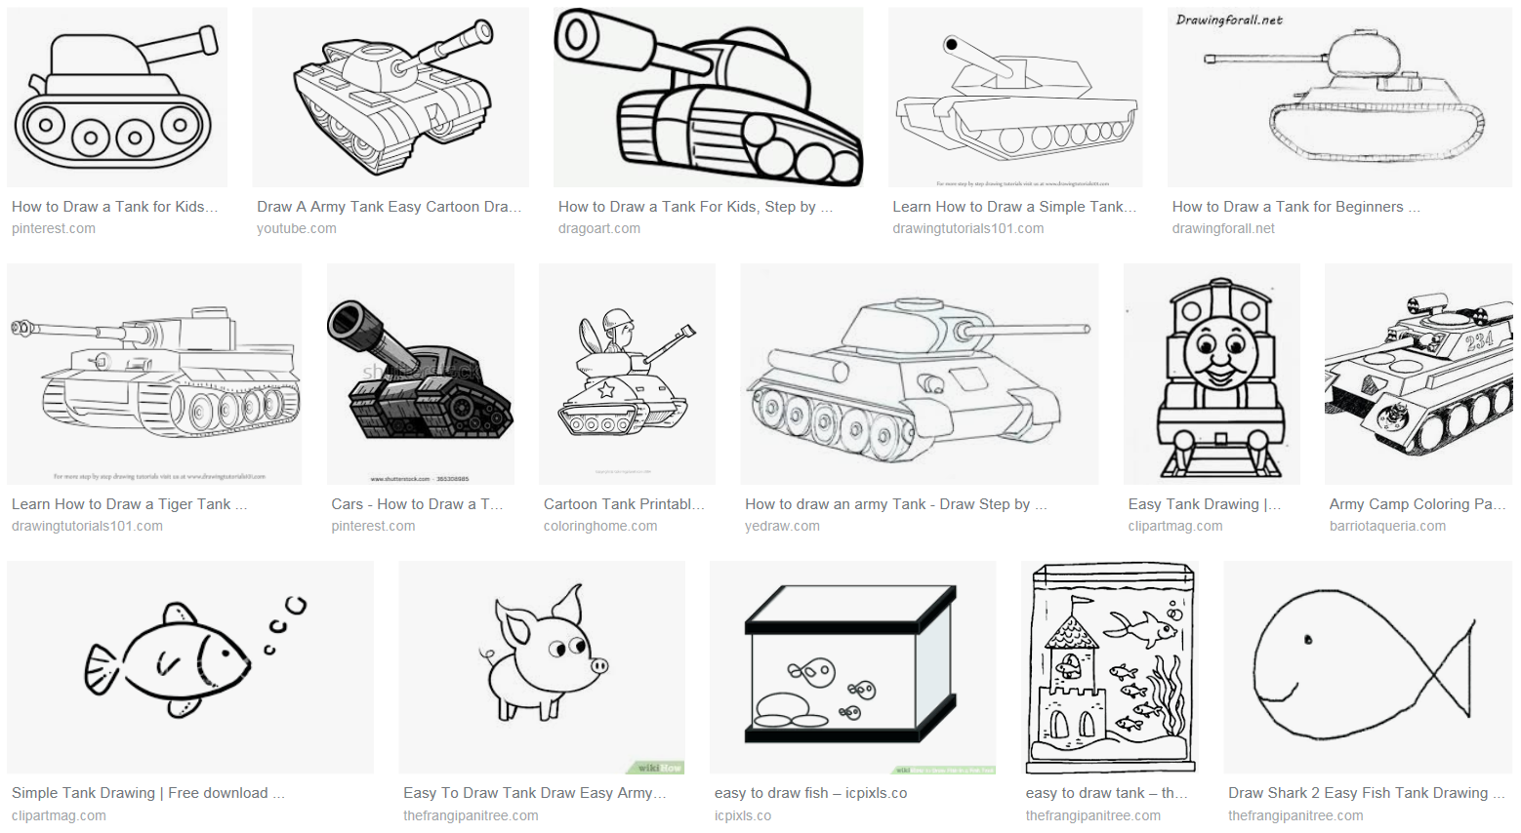
Notice your accepted disharmonies
A riddle
How did the soldier get her tank into her house?
Share your answer with your neighbor.
She carried it in. It was a fish tank.
Who was told the right answer? Show of hands?
What is going on here?
Mental Models! soldier & tank
Why did I tell this riddle?

Slide 8
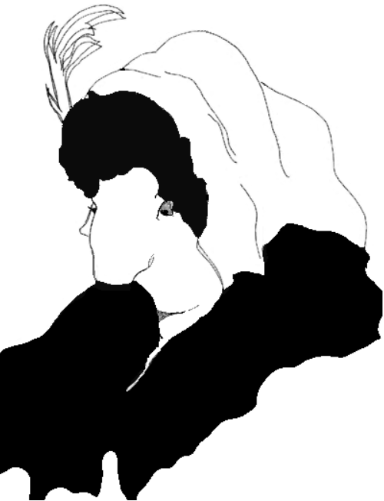
Notice your accepted disharmonies
The value of multiple perspectives
Young Lady, Old Lady?

Slide 9
Notice your accepted disharmonies
The value of multiple perspectives
Young Lady, Old Lady?
ear ring
eye
nose
scarf
chin
nose
necklace
mouth

Slide 10
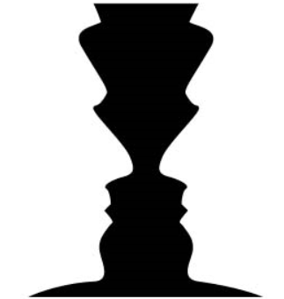
Notice your accepted disharmonies
You ALWAYS have both
Faces or Vases?
Like 2 sides of a coin.

Slide 11

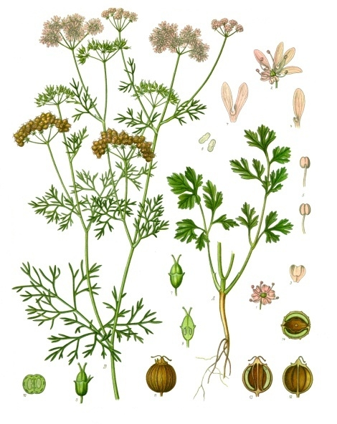
Notice your accepted disharmonies
Sometimes you don’t get to pick
The Dress
There is currently no consensus on why the dress elicits such discordant color perceptions among viewers.
Neuroscientists Bevil Conway and Jay Neitz believe that the differences in opinions are a result of how the human brain perceives color, and chromatic adaptation.
https://en.wikipedia.org/wiki/The_dress
Cilantro

Slide 12

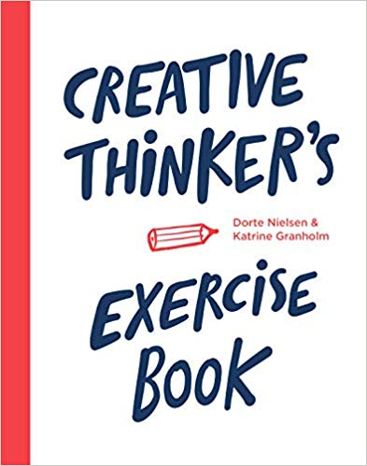
Noticing is a choice
Creativity is learnable
Mindset is expandable
Watch https://foursightonline.com/video/the-secret-of-the-highly-creative-thinker/

Slide 13
Notice your accepted disharmonies
Think purpose, not problem
Reliably perform a use.
Protect a product
Create a housing
Assemble two pieces
Install a bolt
Make a hole
Drill a hole at lower cost
Make a drill bit last longer

Slide 14
Notice your accepted disharmonies
Think purpose, not problem Multiple Solutions at Each Level
Reliably perform a use.
Single use disposable, eliminate need for it
Protect a product
Conformal coating, potting, …
Create a housing
Mold as a unit
Assemble two pieces
Adhesives, self locking, …
Install a bolt
Self tapping screw, blind rivet, …
Make a hole
Laser cut, mold in, stamp, …
Drill a hole at lower cost
Drill type, automation, …
Make a drill bit last longer
Speed, force, lubrication, …
Breakthrough Thinking by Gerald Nadler Article by William Bozeman www.bozemanassociates.com/PDF/Breakthrough%20Thinking%20Overview.pdf

Slide 15
Grown your Edison’s junk pile
For yourself
Notice interesting things
Take stuff apart with your kids (or grandkids)
Designfax http://www.designfax.net/web/home.php
Scientific American https://www.scientificamerican.com/
Remember and discuss the Medici Effect – innovation happens at the intersection of disciplines.
And with a team
Partner with engineering, biomed departments at a university.
Talk with your equipment sales person. Get an intro to one of their engineers.
Talk with your peers, teams about things.
Be realistic. Your ideas aren’t likely worth a million dollars, but document and patent them well, just in case.

Slide 16
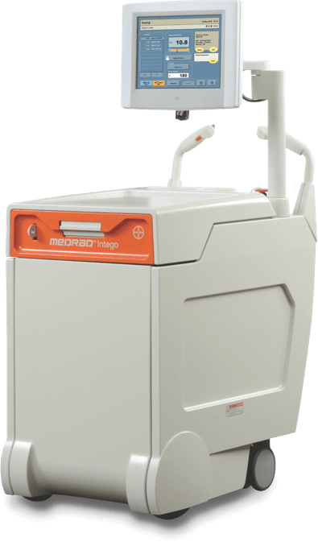
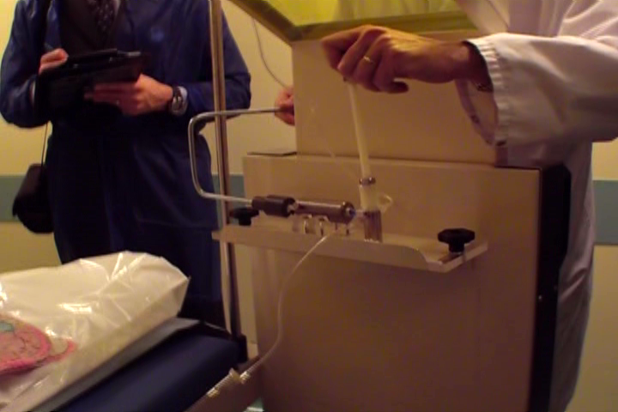
Give things a try.
A injector for PET imaging
A user built solution
Our product

Slide 17
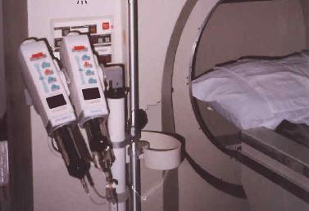
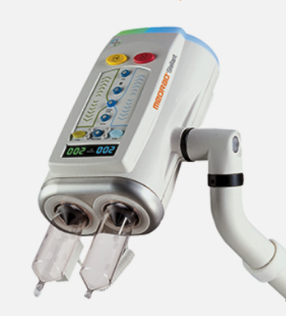
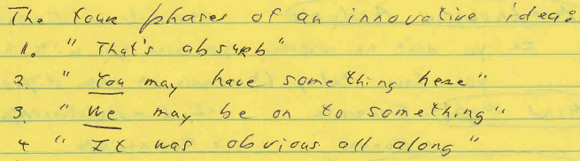
The MEDRAD® Stellant
-Dennis Hack’s notebook (Summer 2000)

Slide 18
How do You Understand and Adjust to the Changing Market Landscape?
Easy to answer. Hard to do.
Step up a level or two or three in your thinking.
Things are the way they are because they got that way. There were good reasons back in the day for the way we do things now. Joiner & Assoc.
Be part of the change you want to see in the world.

Slide 19
A Virtuous Spiral
Medical Device Innovation and Medical Practice Innovation
Faster, Multislice Scanners
Non-ionic Contrast
Personalized Injections
Contrast & Saline to replace layering, Dual Flow
Liver
Mets
In
Minutes
CT Angiography
Injector
adapted
to CT, 1984
Non-equilibrium
Stroke,
3 hr. Liver Mets
CT Invented 1972
X-ray Contrast Infusions
New medical devices make possible the discovery of new medical procedures,
which improve healthcare, AND fund and motivate innovation in medical devices.

Slide 20
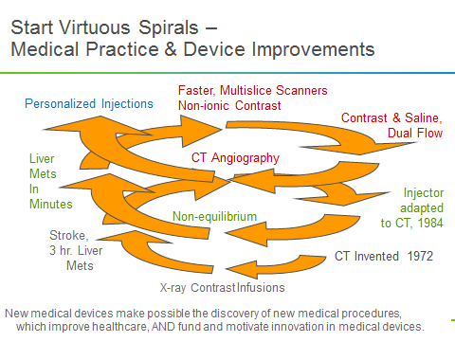
Injector growth – It can appear to be accidental
MEDRAD grew 16% per year for 25 years. How did that happen?
There have been two significant examples of over the horizon big wins in our injector growth history.
In 1983 MEDRAD entered the CT injector market with a modified angiography injector. The targeted procedure was stroke imaging. Initially sales were slow until doctors discovered that using the injector to deliver a long bolus allowed them to look for cancer metastasized to the liver without requiring a 3 hour absorption delay between injection and scan. This discovery led the way to significantly increased CT injector and contrast sales.
In the 1990’s nonionic contrast agents were new to the market and expensive. Some doctors were filling the injector syringe with half contrast and half saline to reduce contrast usage and cost. This lead to us providing the option of dual syringes on the Stellant injector. The Stellant dual syringe injector became the standard for CT injection systems and the ability to tightly control contrast and saline injections is now a requirement for CT angiography - a CT procedure which hadn't even been invented at the time of Stellant's introduction.

Slide 21
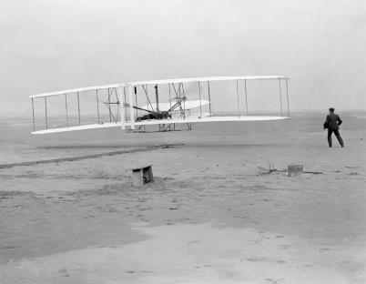
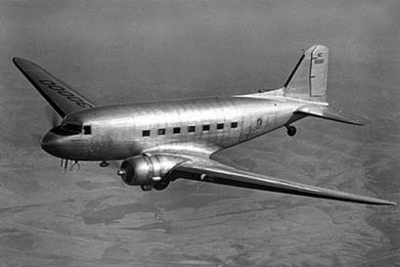




Innovation “Magically” Happens When
All the Key Pieces to Come Together – The DC-3 Effect
December 1903, the Wright proved that powered flight was possible.
Thirty years later …
the McDonnell Douglas DC-3, introduced in 1935, ushered in the era of commercial air travel.
The DC-3, for the first time, brought together five critical component technologies that formed a successful ensemble.
They were: the variable-pitch propeller, retractable landing gear, a type of lightweight molded body construction called "monocoque", radial air-cooled engine and wing flaps. To succeed, the DC-3 needed all five; four were not enough.
One year earlier, the Boeing 247 was introduced with all of them except wing flaps. It wasn’t a success. Peter Senge The Fifth Discipline
Breakthroughs happens because we are growing as part of an innovating ecosystem.

Slide 22
Innovation “Magically” Happens When
All the Key Pieces to Come Together – The DC-3 Effect
Then I learned that the DC-3 won for economic reasons, it had 50% more capacity that the Boeing 247, 7 rows of 3 vs 7 rows of 2. Tom Petzinger, Hard Landings
December 1903, the Wright proved that powered flight was possible.
Thirty years later …
the McDonnell Douglas DC-3, introduced in 1935, ushered in the era of commercial air travel.
The DC-3, for the first time, brought together five critical component technologies that formed a successful ensemble.
They were: the variable-pitch propeller, retractable landing gear, a type of lightweight molded body construction called "monocoque", radial air-cooled engine and wing flaps. To succeed, the DC-3 needed all five; four were not enough.
One year earlier, the Boeing 247 was introduced with all of them except wing flaps. It wasn’t a success. Peter Senge The Fifth Discipline
The Boeing 247 had flaps, but didn’t need them. The DC-3 was the first plane to require flaps to fly given the higher wing loading to carry the additional passengers. Pilot - Robert Uber
Aluminum had once been the most expensive metal in the world. It wasn’t until the 1920’s that an all aluminum plane was possible
The Fokker F-10, a leading plane before the DC-3, was grounded because of cracking of their wooden wing beam.
It takes multiple TRUE perspectives to really understand something, thus it is said, “by the mouth of two or three witnesses the matter shall be established.” Deuteronomy 19:15 (NKJV)
Breakthroughs happens because we are growing as part of an innovating ecosystem.

Slide 23


“Accidental” Injector Growth – It is Actually the DC-3 Effect
Once the principle is understood, it can be used.
The CT Injector market discoveries look accidental, but they are partially explained by Peter Senge’s DC-3 Effect story.
The companies in our imaging “ecosystem” are innovating in their own spaces, and these sometimes simple separate innovations can come together to create a breakthrough.
"On a cold, clear morning in December 1903, at Kitty Hawk, North Carolina, the fragile aircraft of Wilbur and Orville Wright proved that powered flight was possible.
Thus was the airplane invented; but it would take more than thirty years before commercial aviation could serve the general public… the McDonnell Douglas DC-3, introduced in 1935, ushered in the era of commercial air travel."
"The DC-3, for the first time, brought together five critical component technologies that formed a successful ensemble. They were: the variable-pitch propeller, retractable landing gear, a type of lightweight molded body construction called "monocoque", radial air-cooled engine and wing flaps. To succeed, the DC-3 needed all five; four were not enough.”
“One year earlier, the Boeing 247 was introduced with all of them except wing flaps. Lacking wing flaps, Boeing’s engineers found that the plane was unstable on take-off and landing and had to downsize the engine." Peter Senge Fifth Discipline

Slide 24
“Accidental” Injector Growth – It is Actually the DC-3 Effect
But even Senge’s DC-3 Effect Isn’t the Complete Picture.
Upon hearing the DC-3 Effect story, Tom Petzinger, the author of Hard Landings, explained to me that the DC-3 won for economic reasons, it had 50% more capacity that the Boeing 247, 7 rows of 3 people vs. Boeing’s 7 rows of 2. So the DC-3 generated 50% more revenue for about the same costs.
Later Robert Uber, a private pilot, explained that Boeing 247 didn’t need flaps. The DC-3 was a hastily enlarged version of the DC-2 which had carried 14 people. Douglas enlarged the cabin but not the wings, so it was the first plane to require flaps to fly given the higher wing lift needed to take off with the additional weight.
Wikipedia explains that United Airline pilots had objected to the use of Hornet engines (in the Boeing 247) because most pilots were accustomed to the less-powerful Wasps and found the Hornets overpowering. But once Boeing incorporated the smaller engines, they couldn’t easily change to larger ones, and so catch up to the DC-3. It is ironic that doing what the “customer” requested kept them from doing what the customer needed..
In the 1800’s aluminum was the most expensive metal in the world. It was only by the 1920’s that aluminum price came down enough to build an all aluminum airplane.
A leading passenger plane of that day, the Fokker F-10 had a spruce wing beam. Some were cracking and so they were all grounded a few year before the DC-3 came out.
Notice how many perspectives it takes to fully picture what is going on!
The CT Injector market discoveries look accidental, but they are partially explained by Peter Senge’s DC-3 Effect story.
The companies in our imaging “ecosystem” are innovating in their own spaces, and these sometimes simple separate innovations can come together to create a breakthrough.
https://epdf.pub/landmarks-in-modern-american-business.html

Slide 25


When Summiting – The mountain top (the market) is visible to all
In Spelunking – The caverns (the bigger markets)
can only be discovered by going in and exploring.

Slide 26

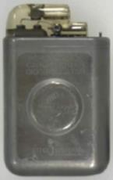
Summiting – Climbing to the Top of the Mountain
A mountain represents a large market whose size and value is knowable before the effort begins.
Getting to the summit is a big project and risky. It takes lots money, time, hard work and some creative breakthroughs along the way. The best path to the top is not known until one starts to climb.
Most therapeutic drug discovery and commercialization projects fit the mountain climbing metaphor. New targets and new molecules need to be developed and proven, but success is known to result in access to a billion dollar market. The risks are primarily other than market risks.
MEDRAD’s development of the world’s
first implantable defibrillator from 1972 to
1985 was a mountain climbing effort in
the medical device world.

Slide 27

Spelunking – Exploring a Cave
Exploring a cave is almost the opposite of summiting. You can only see as far as your flashlight can shine.
You start down a path because you see a market, but once you go around a bend, the actual market may be non-existent, tiny, modest, or MUCH bigger than what you thought before you started.
This is the Big Room at Carlsbad Caverns in New Mexico, USA
The area of the room is large enough to contain up to 7 football fields with a height comparable to a 10 story building.
It's discovery required entering and exploring many paths, going 2 km into the cave and descending 330 m.

Slide 28
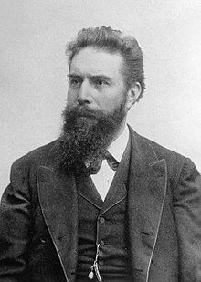

Things take a while
1895 Wilhelm Conrad Röntgen discovered X-rays.
Angiography was first done in 1927 by the Portuguese physician and neurologist Egas Moniz at the University of Lisbon.
With the introduction of the Seldinger technique in 1953, the procedure became markedly safer as no sharp introductory devices needed to remain inside the vascular lumen.
Seldinger technique: needle, guidewire, remove needle, blunt sheath, (remove guidewire), proceed with the procedure. Wikipedia – angiography
“To do angiography you needed:
  a fast, biplane X-ray machine & film changer that exposes
  6 films per second,
  guidewires,
  catheters,
  contrast,
  and an injector.”
  AND
  Doctors
  Researchers
  Software
  Businesses
(1958) Chapter 2: Equipment, Acta Radiologica, 49:sup158, 14-17, DOI: 10.3109/00016925809171040

Slide 29
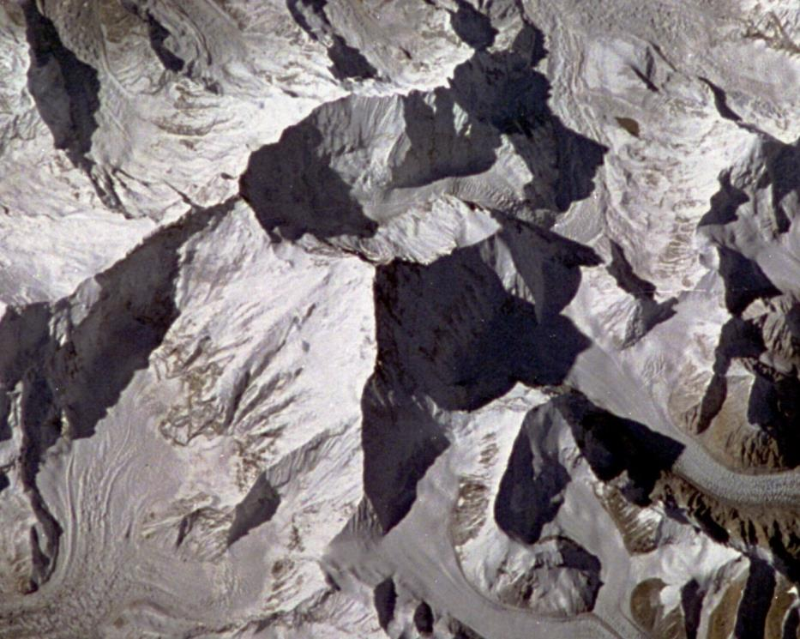
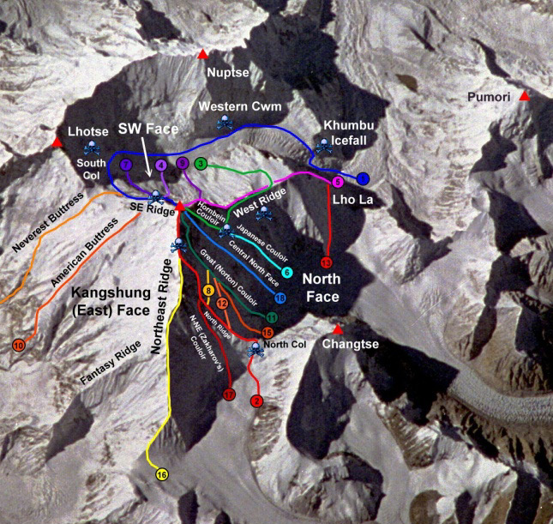

With this understanding, we can consciously help gather or facilitate innovations by our “ecosystem” to meet unmet medical needs
This can be pictured as a Medical Mt. Everest
Mammography
Think about breast cancer screening for women with dense breasts as the peak of Mt. Everest.
There are several teams or ecosystems trying to get to the peak.
Mammography and Digital breast tomosynthesis can’t make it.
It’s too early to tell which of the remaining approaches will reach the summit first or gain the biggest market share.
The goal is to be part of as many of the ecosystems a possible with the best products and knowledge possible.
Digital Breast Tomo
Contrast enhanced Mammo
Dedicated
Breast CT
with contrast
Ultrasound (with contrast)
Abbreviated Breast MR
with contrast
Dynamic PET with FDG
Mt. Everest as seen from the Space Shuttle
29

Slide 30
Some theories around innovation
Prof. Clayton Christensen’s materials
The Innovator’s Dilemma
Three lectures at Oxford in 2013
  https://www.youtube.com/watch?v=rpkoCZ4vBSI ,
  http://youtu.be/Ei57yFEljrI ,
  http://youtu.be/WJzYTxXH7R0
How will you measure your life? TEDX
  https://www.youtube.com/watch?v=tvos4nORf_Y
Clayton Christensen on capitalism and religion
  http://bigthink.com/videos/clayton-christensen-on-religion-and-capitalism
Key articles
  https://hbr.org/2020/01/the-essential-clayton-christensen-articles

Slide 31

How do You Understand and Adjust to the Changing Market Landscape?
Step up in your systems perspective - Ecosystems Innovate
Understand and discuss how things happen in a device ecosystems. Use metaphors: mountain climbing, spelunking, the DC-3 effect and medical Mt. Everests.
Be patient AND be quickly and cost effectively trying things that are new to the world or new to your world.

Slide 32
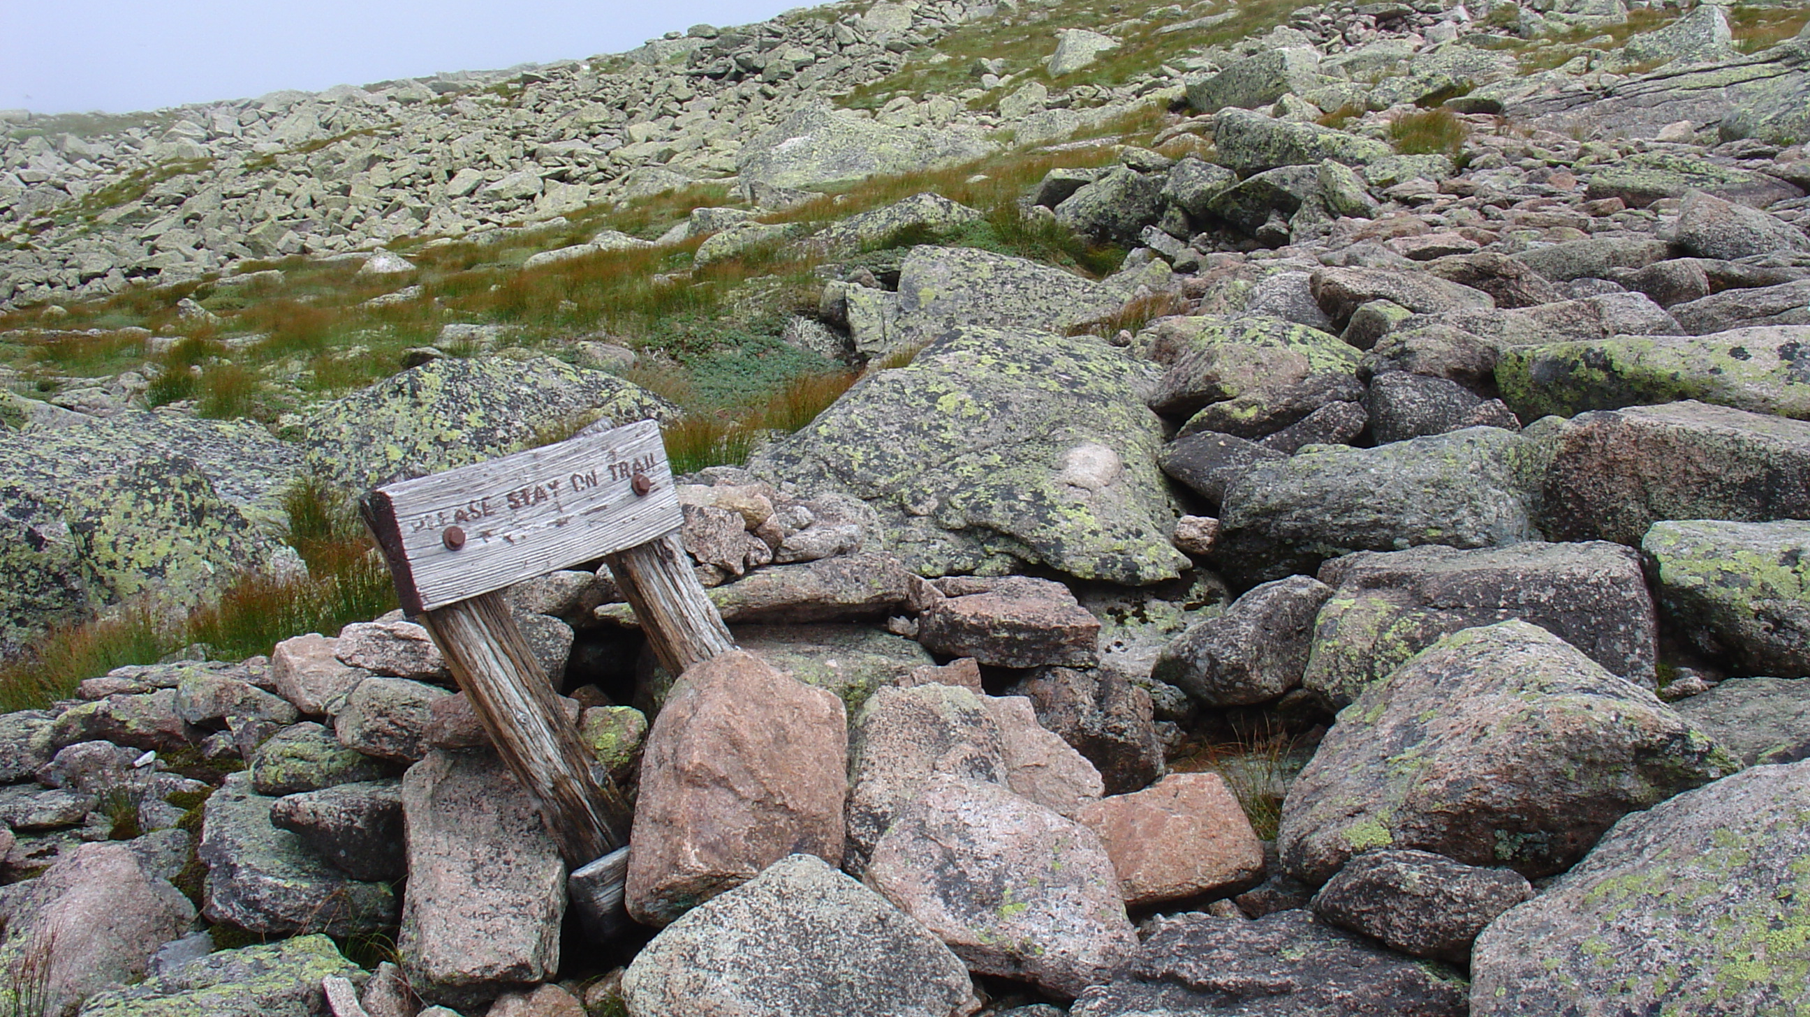
Be patient
AND persistent
Step up in your
systems perspective –
Ecosystems Innovate
Grow your Edison’s junk pile
Notice accepted disharmonies

Slide 33
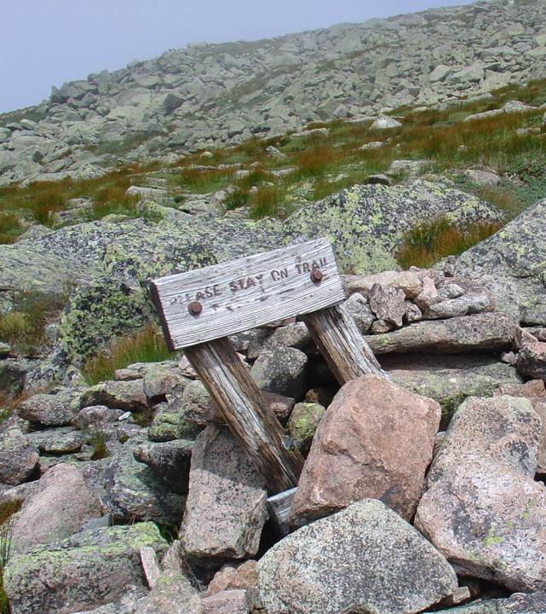
Thank you for your time!
Have a good day!
I’d love to hear your questions, thoughts, or additions.
ned.uber@bayer.com

