Slide 1
Generative AI: Today and Tomorrow
Sarah F. Hoffman
VP, AI and Machine Learning Research

Slide 2

Notes:
In the last decade, we’ve been in an AI Spring and saw the benefit of AI in many ways. But now, we’re about to face a long AI summer that will open-up massive opportunities across industries. Artificial intelligence is now on the verge of being fully democratized, and this will impact us both as customers and in our jobs as knowledge workers.

Slide 3

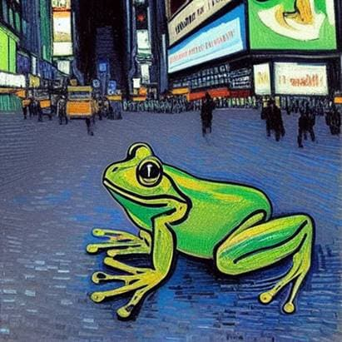
April 2022: We can all be artists
Image generated using DALL-E 2: “happy golden retriever with a cup of coffee at a café”
Image generated using Stable Diffusion: “A frog in Times Square New York by Van Gogh”
Notes:
In April 2022, we all became artists. Dalle-2, midjourney , stable diffusion... Numerous Text to Image AI tools came to the horizon that anyone could use – no need to know anything about art or technology to create an amazing image.
Now you just need to type a simple phrase like “happy golden retriever with a cup of coffee at a café” to get an image that never existed before.
Now let’s fast forward to November.

Slide 4
November 2022: OpenAI Releases ChatGPT
The information regarding AI tools provided herein is for informational purposes only and is not intended to constitute a recommendation, development, security assessment or advice of any kind. Generative AI models including ChatGPT have limitations and risks. They do not typically include current and verified data and are known to create inaccurate information. Consider your own use case carefully and understand the risks before utilizing a generative AI tool.
Notes:
OpenAI released ChatGPT.
Similar to its predecessor, GPT-3, it can do almost anything you can imagine with text – Summarize it, find topics and companies mentioned, write text from scratch on any topic.
But unlike GPT-3, there was no waitlist or cost; ChatGPT was released for free for anyone to use.
We can now all be writers too.

Slide 5
Write a social media post explaining cryptocurrencies – the pros and the cons – in under 100 words.
Thinking about investing in cryptocurrencies like Bitcoin or Ethereum? It's important to understand both the pros and the cons. On the plus side, cryptocurrencies offer the potential for high returns and are decentralized, meaning they are not controlled by any government or financial institution. However, they are also highly volatile and have been subject to numerous cyber attacks and scams. Make sure to do your research and understand the risks before diving in.
Notes:
I asked it to “Write a social media post explaining cryptocurrencies – the pros and the cons – in under 100 words.” and got a great reply. You definitely want to verify it and probably tweak it – but it’s still a huge time saver.

Slide 6
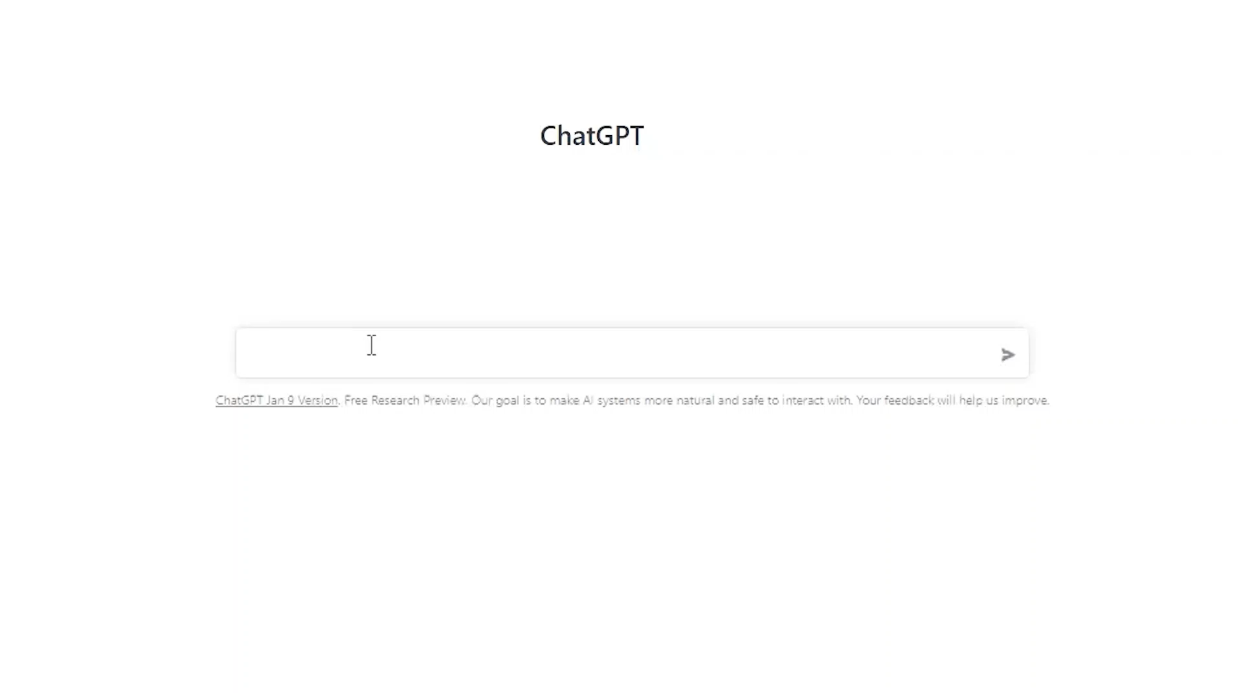
Notes:
What about for financial literacy purposes?
I asked “How can I explain a 401k to a teenager”
-retirement savings plan
-employees contribute a portion of their salary
- employers may offer matching contributions

Slide 7
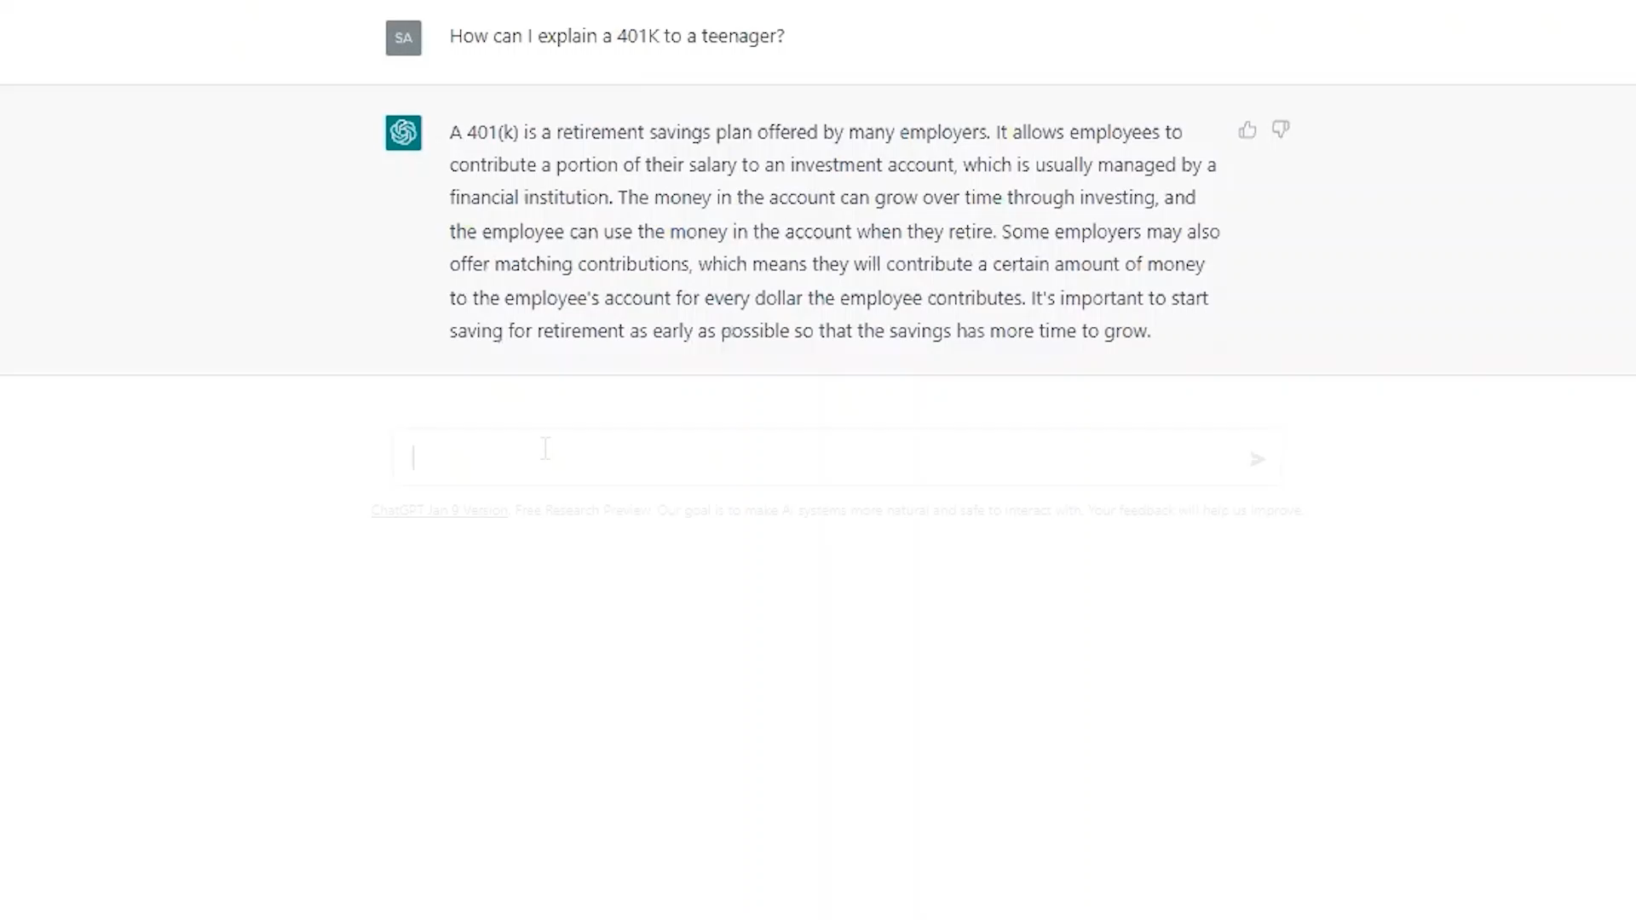
Notes:
- chose a common sport Basketball
---Similar to the coach who helps the players improve by giving them tips, the 401k plan administrator can help you invest your money so that it grows
-the more you save and invest early, like starting to play basketball at a young age the better off you will be in the long run.

Slide 8
We would like to develop an app to help people save more money. Any suggestions?
Certainly, here are some key features that could be included in your app to help people save more money:
Budget tracking: Allow users to input their income and expenses, and then track their spending against their budget. This will help them identify areas where they can cut back and save more money.
Bill reminders: Send notifications to users reminding them of upcoming bills, so they can be prepared and budget for them.
Savings goals: Help users set and track savings goals, such as building an emergency fund or saving for a down payment on a house.
Investment advice: Offer advice and resources on how to invest their money and grow their savings over time.
Cash-back rewards: Partner with merchants to offer cash-back rewards for purchases made through the app.
Round-up savings: Automatically round up users' purchases to the nearest dollar and transfer the difference into a savings account.
Personalized tips: Provide personalized tips and suggestions to users on how they can save money based on their spending habits and financial situation.
I hope these ideas help you in developing your app!
Notes:
Large language models can also be very useful as a brainstorming tool, whether it’s for new product ideas, marketing campaigns, companies to invest in, or ways to use emerging technology. In this example, I asked “we would like to develop an app to help people save more money. Any suggestions?” One critical challenge with generative AI today is that you can’t really trust the answers. When it comes to brainstorming, the point is to find new ideas or spark provocative conversations, the verifiability of the answer is not as important as the novelty of the insight.
If one of these 7 ideas returned, makes no sense, I can ignore it. And I can ask follow-up questions on any of the other ideas that do resonate with me.

Slide 9
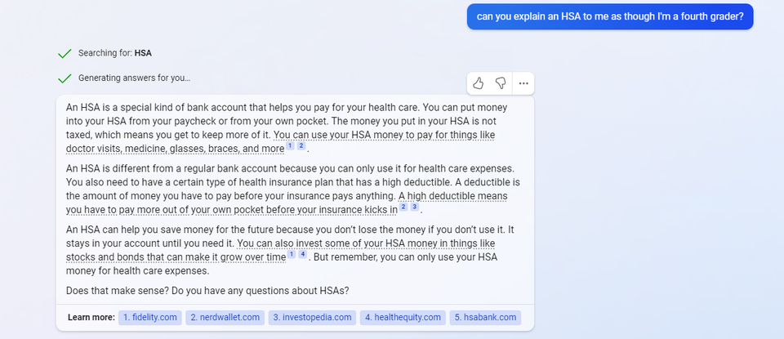
Notes:
These technologies are now being incorporated into search engines. Microsoft and Google both have a version of large language model technology in their search engines now. In this example, I ask Microsoft’s new version of Bing which uses OpenAI’s generative AI technology to explain a Health Savings Account to me as though I’m a fourth grader. And it does a great job: now I can even get sources to verify the results and it uses appropriate medical examples for a fourth grader: glasses and braces.

Slide 10

Notes:
But we need to be cautious when using this technology. Firstly, today it’s only trained until September 2021 and as mentioned before, it hallucinates, making it not trustworthy. But there are some other pretty large issues.

Slide 11
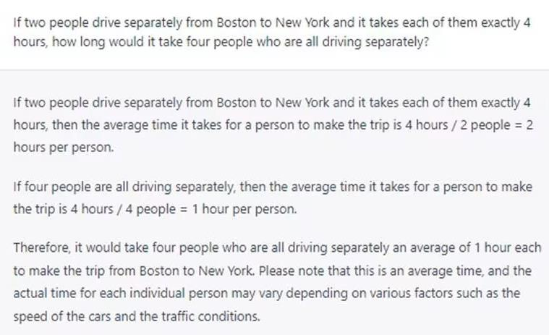
Notes:
It does not understand what it’s saying. It does not actually have intelligence.

Slide 12
Recently, Fidelity Investments, looking to attract younger, more diverse investors, partnered with My Little Pony and added a dash of millennial pink to its website.
Notes:
I typed in the black text “Recently, Fidelity Investments, looking to attract younger, more diverse investors, partnered with” and I let GPT-3 finish the sentence for me. The pink text is how it finished the sentence.

Slide 13
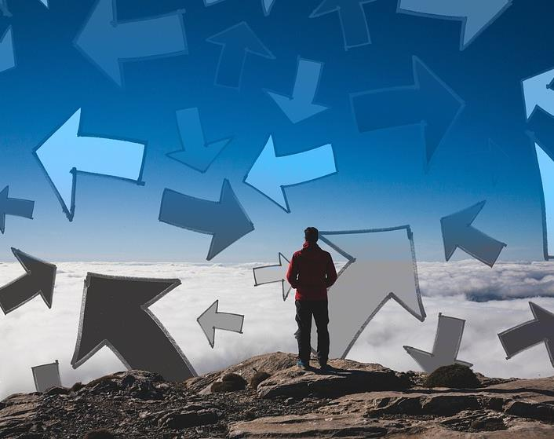
Can generative AI be a silo breaker?
Notes:
Yet while many questions remain, if we can figure out how to best use this technology, what else is possible?
Could more sophisticated AI be a silo-breaker, helping share knowledge within large companies, leading to more collaboration and greater efficiency?
(creative common PPT image)

Slide 14
How might user interfaces change?
Notes:
One of the most powerful things about generative AI tools is that many of them have only one textbox that can do so many different things, making it easy for anyone to use.
Can we change user interfaces so each website only has one text box and no need to know how to navigate across multiple tabs?

Slide 15
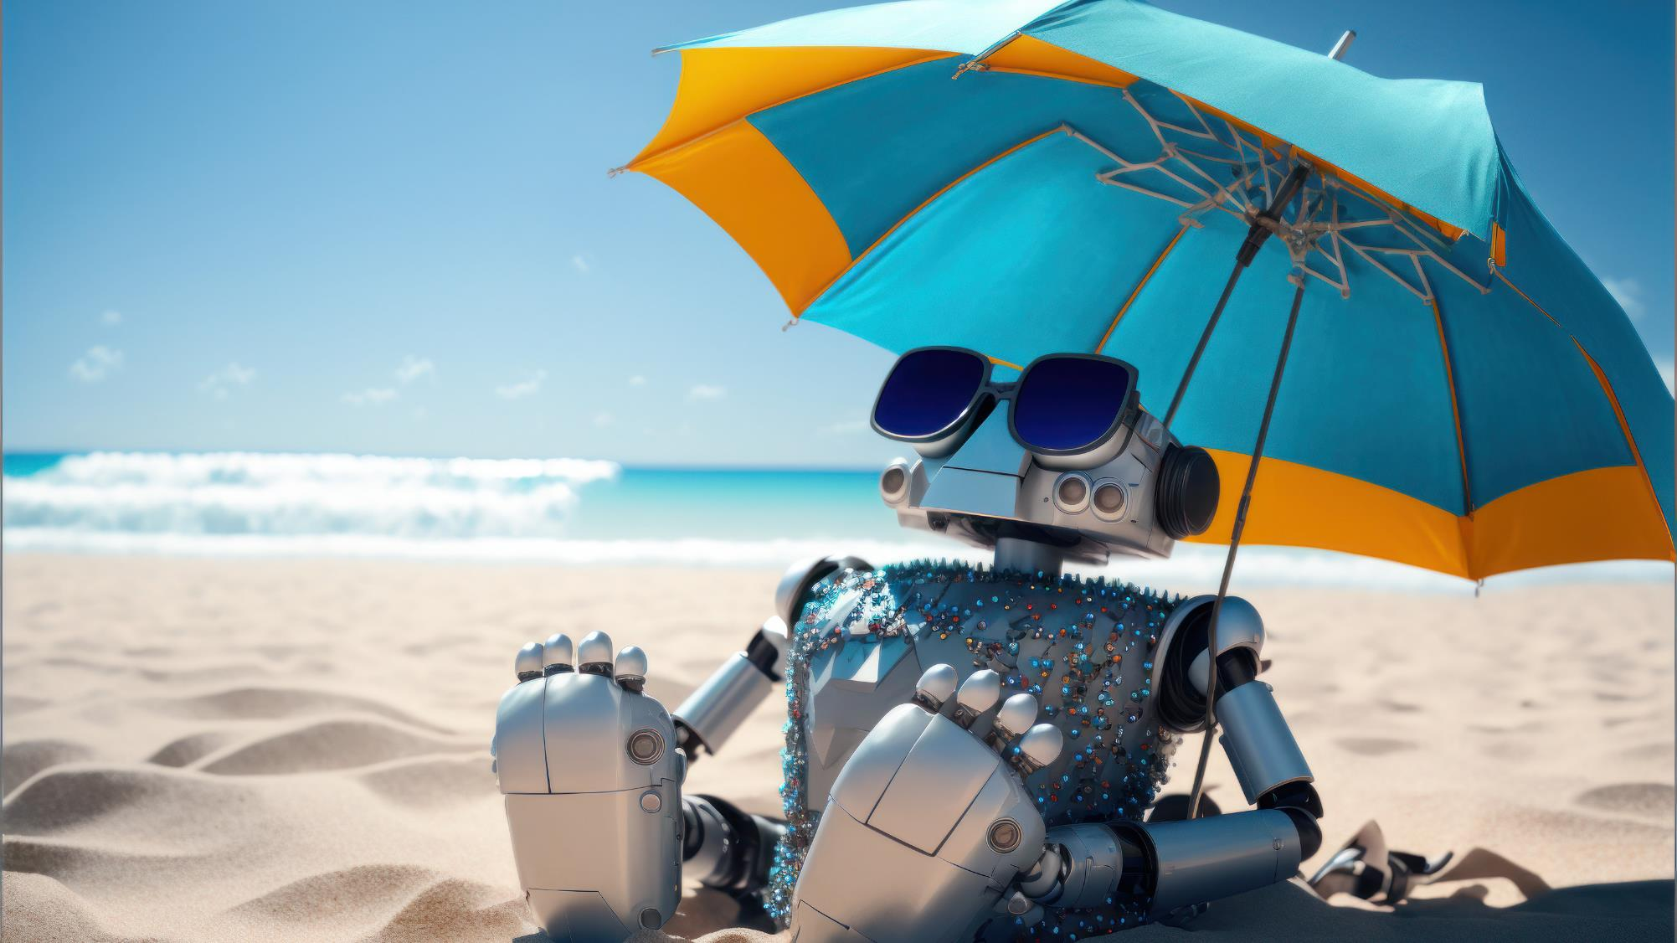
Notes:
Generative AI creates numerous opportunities across industries. Let’s figure out how to make this AI summer one of the best summers of our lives.
(AdobeStock_564787214)

Slide 16


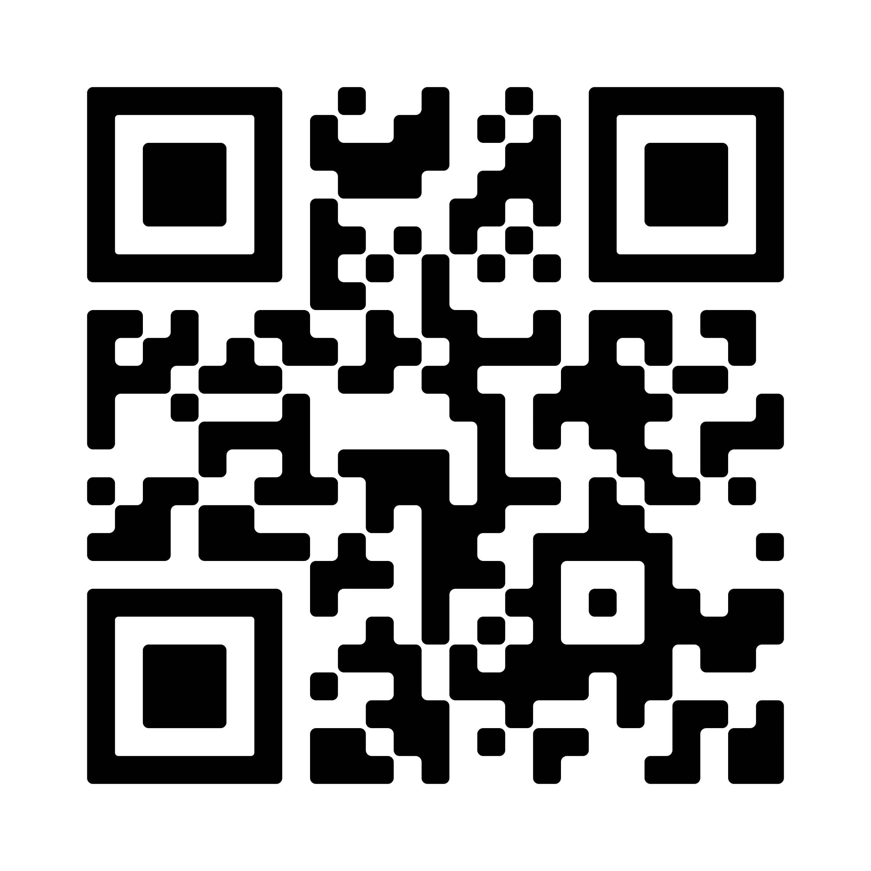
Engage with us!
Information provided in this document is for informational and educational purposes only.
Fidelity Center for Applied Technology (FCAT) provides innovative products, services, content and tools, as a service to its affiliates and as a subsidiary of FMR LLC. Based on user reaction and input, FCAT is better able to engage in technology research and planning for the Fidelity family of companies. Unless otherwise indicated, the information and items presented are provided by FCAT and are not intended to provide tax, legal, insurance or investment advice and should not be construed as an offer to sell, a solicitation of an offer to buy, or a recommendation for any security by any Fidelity entity or any third-party.
Third-party trademarks and service marks are the property of their respective owners. All other trademarks and service marks are the property of FMR LLC or its affiliated companies.
© 2023 FMR LLC. All rights reserved.
1086932.1.0

