Slide 1
Artificial Intelligence in Health
Today - Next Year - 5 Years
Deborah Di Sanzo, President Best Buy Health

Slide 2











Best Buy Health: We enable care at home for everyone.
Wellness at Home
Aging at Home
Care at Home
Staying Well
Getting Well
Wellness
Condition Management
Social Care
Urgent Response
On-Demand Telehealth
Transitional Care
Chronic Care
Hospital at Home
Health tech and wellness products for use in the
home and beyond
Health and safety tech and services for aging adults
  Tech-enabled solutions that connect patients to care teams to enable care at home
2
Omnichannel
Enabling services
Logistics
Connected technology
Human connection
Platform
Best Buy’s Unique Capabilities

Slide 3
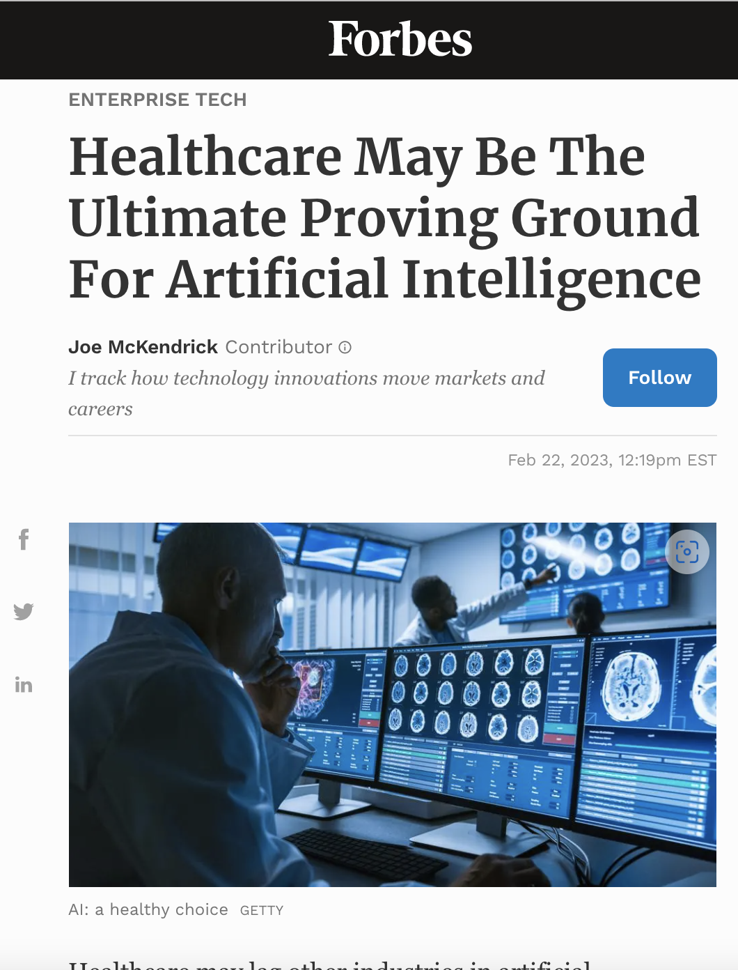
The Opportunity for AI is now.
25% of US healthcare spending is administrative costs
McKinsey 2019.
51% of a physician’s day is spent in the EHR leading to burnout
Health Affairs 2017.
41% of nurses time is spent on documentation, and
92% of nurses express job dissatisfaction
JNM 2017 and ANA Workplace Survey 2022.
6% of medical school curriculum will be relevant in ten years NEJM 2019.
5 to 10% US health care spending can be saved with wider AI
adoption—roughly $200 billion to $360 billion annually
National Bureau of Economic Research September 2022.
“
Notes:
https://www.nber.org/books-and-chapters/economics-artificial-intelligence-health-care-challenges/potential-impact-artificial-intelligence-healthcare-spending
Sahni NR, Kumar P, Levine E, Singhal S. The productivity imperative for healthcare delivery in
the United States. McKinsey & Company. February 27, 2019.
Health Affairs Vol 36, No 4 April 2017
Studies reported nurses spent 26.2 - 41% of their time on documentation^{51,52}. Schenk E, Schleyer R, Jones CR, Fincham S, Daratha KB, Monsen KA. Time motion analysis of nursing work in ICU, telemetry and medical-surgical units. J Nurs Manag. 2017 Nov;25(8):640-646. doi: 10.1111/jonm.12502. Epub 2017 Aug 29. PMID: 28853187.
American Nurses Foundation, Pulse on the Nation's Nurses COVID-19 Survey Series: Workplace Survey, June-July 2022.
Rajkomar A, Dean J, Kohane I. Machine learning in medicine. N Engl J Med. 2019 Apr
4;380(14):1347-1358.

Slide 4



AI is the EHR Tipping Point.
GBT-4 is VERY different than what came before. This trio will help, finally.
Nuance
ChatGPT-4
Epic Systems
Conversational AI
Large Language Model (LLM)
Leading Electronic Health Record
Capture patient/physician conversation in exam
- Provide relevant information
- Generate the physician note
- Assign billing codes, prior auth
- Generate after visit summaries
Integrated into the EHR workflow
““Integrating generative AI into some of our daily workflows will increase productivity for many of our providers, allowing them to focus on the clinical duties that truly require their attention.” Chero Goswami, CIO at UW Health. Healthcare IT News. April 18, 2023.
Notes:
Today: limited conversation, notes, search.
This year: Nuance will link conversation to SOAP to codind. Epic is using Azur
5 years: complete language capture and search in ED, physician office, patient similarity.
Nividia study: A large language model for electronic health records | npj Digital Medicine (nature.com)
https://www.nature.com/articles/s41746-022-00742-2
(subjective, objective, assessment, plan)
https://www.healthcareitnews.com/news/epic-microsoft-partner-use-generative-ai-better-ehrs
https://www.healthcareitnews.com/news/epic-microsoft-partner-use-generative-ai-better-ehrs

Slide 5
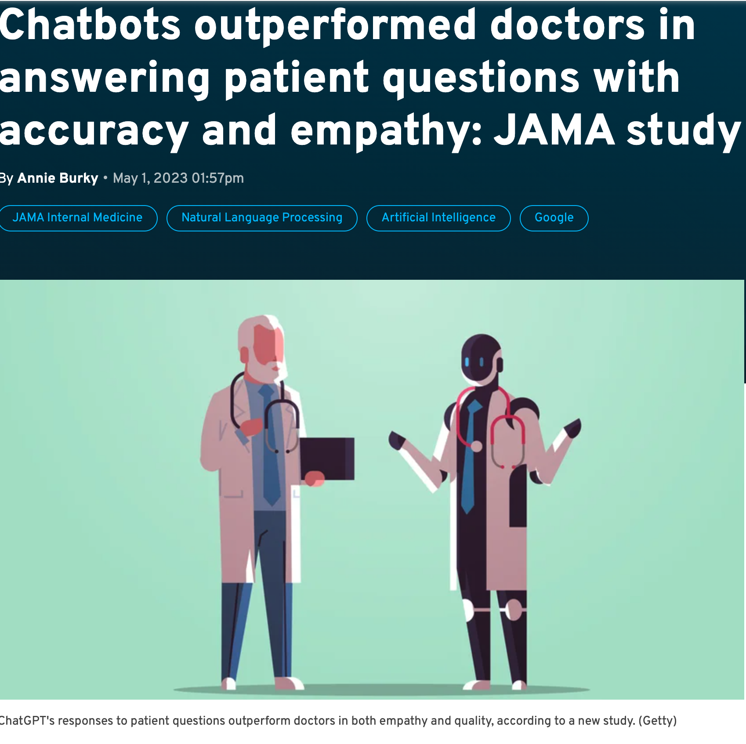
Consumer Chatbots will be a game changer.
Chatbots responses were preferred over physician responses in over 78% of the evaluations.
Evaluators preferred the chatbot responses 4 to 1
Chatbot responses were longer
Chatbot responses were rated higher for quality and empathy
Questions r/AskDocs: JAMA Intern Med. April 28, 2023
The rise in patient messaging is contributing to clinician burnout.
The new Chatbots will use generative AI.
Assist in writing answers to patient’s questions
Reduce unnecessary office visits
Help patients understand medical guidance
Boost compliance through better understanding
Improve patient satisfaction
Notes:
Today: experiment. This year: leading systems and payors chat bots. 5 years: 70% questions answered by chat bots, Cognitive assistants.
Study
https://jamanetwork.com/journals/jamainternalmedicine/fullarticle/2804309
yers JW, Poliak A, Dredze M, et al. Comparing Physician and Artificial Intelligence Chatbot Responses to Patient Questions Posted to a Public Social Media Forum. JAMA Intern Med. Published online April 28, 2023. doi:10.1001/jamainternmed.2023.1838
“In this cross-sectional study of 195 randomly drawn patient questions from a social media forum, a team of licensed health care professionals compared physician’s and chatbot’s responses to patient’s questions asked publicly on a public social media forum. The chatbot responses were preferred over physician responses and rated significantly higher for both quality and empathy.”
Picture
https://www.fiercehealthcare.com/ai-and-machine-learning/chatbots-outperformed-physicians-answering-patient-questions-accuracy-and
STAT: How can medical chatbots seem so empathetic? May 4, 2023
Patient Messaging also contributes to physician burn out.

Slide 6
What did GPT-4 say?
hello, I am giving a presentation on consumer chatbots in healthcare, where do you think chatbots will be in 5 yrs?
ChatGPT. (answer by ChatGBT, formatting by Deborah Di Sanzo)
Hello! Chatbots in healthcare have seen significant advancements in recent years, and their potential continues to grow. While I can't predict the future with certainty, I can speculate on some potential developments for chatbots in the healthcare industry over the next five years based on current trends and advancements.
Enhanced Natural Language Processing (NLP): Chatbots will likely become more adept at understanding and interpreting natural language, enabling them to provide more accurate and contextually relevant responses. They may employ advanced NLP techniques, such as sentiment analysis and language understanding, to better understand user queries and provide personalized assistance.
Improved Diagnostic Capabilities: With advancements in machine learning and access to vast medical databases, chatbots may become increasingly proficient in offering preliminary diagnoses based on user symptoms. However, it's important to note that these diagnoses would still need to be verified by medical professionals.
Expanded Healthcare Integration: Chatbots could integrate more seamlessly with healthcare systems, electronic health records (EHRs), and other health tech platforms. This integration would allow chatbots to access and provide real-time patient data, offer appointment scheduling, prescription refills, and securely communicate with healthcare providers.
Personalized Health Recommendations: As chatbots gather more information about individuals, including their medical history, lifestyle, and preferences, they may be able to provide personalized health recommendations. These could include dietary advice, exercise plans, medication reminders, and tailored information based on specific health conditions.
Mental Health Support: Mental health chatbots are already making a positive impact, and their role is expected to expand further. In the coming years, chatbots may offer more comprehensive mental health support, including emotional assistance, guided meditation, coping techniques, and resources for accessing professional mental health services.
Virtual Assistants for Elderly Care: As the aging population grows, chatbots may play a crucial role in providing virtual assistance for the elderly. These chatbots could remind patients to take medication, help with daily tasks, and offer companionship, reducing social isolation and enhancing overall well-being.
Ethical Considerations: With the increasing use of chatbots in healthcare, ethical considerations surrounding data privacy, security, and transparency will become more critical. Stricter regulations and guidelines may be implemented to ensure the responsible and ethical use of chatbot technology.
Remember that these are speculative possibilities, and the actual progress and adoption of chatbots in healthcare will depend on various factors such as technological advancements, user acceptance, regulatory frameworks, and ethical considerations.

Slide 7
Thank you, can you make your answer more concise?
ChatGPT (answer by ChatGBT, formatting by Deborah Di Sanzo)
Certainly! Here's a more concise version of potential advancements for chatbots in healthcare over the next five years:
Enhanced Natural Language Processing: Chatbots will better understand and respond to user queries.
Improved Diagnostic Capabilities: Chatbots may offer preliminary diagnoses based on symptoms.
Expanded Healthcare Integration: Integration with healthcare systems and EHRs for better data access and communication.
Personalized Health Recommendations: Chatbots may provide tailored advice based on individual data.
Mental Health Support: Chatbots could offer comprehensive mental health assistance.
Virtual Assistants for Elderly Care: Chatbots may assist the elderly with reminders and daily tasks.
Ethical Considerations: Stricter regulations to ensure responsible and ethical chatbot use.
Please note that these are possibilities and may not reflect the exact developments that will occur in the future.

Slide 8
AI is revolutionizing drug discovery.
Research and drug discovery
Pre-clinicals
Phase I
Phase II
Phase III
approval
AlphaFold 2 from DeepMind, predicts the shapes of over 200 million proteins -- helping researchers identify drug targets and design drugs that interact with the protein.
“Determining the 3D structure of a protein used to take many months or years, it now takes seconds.” Eric Topol, Director of the Scripps Research Translational Institute.
Knowledge Graphs capture relationships between genes, proteins, diseases, and compounds -- helping researchers speed drug discovery.
Large Language Models will improve clinical trials by predicting the best methods to use based on learning from all previous clinical trials.
Clinical trials require humans to read thousands of clinical notes. A LLM can read the notes and select inclusion and exclusion criteria.
AI has the power to collapse the silos of drug discovery and speed time to therapy.
Notes:
There is good reason that the Life Sciences Companies are looking to artificial Intelligence to help with drug discovery and developmentwe see that it takes $1.5 to $2 billion to bring a new drug to market, and less than 10% of compounds entering clinical trial make it to market. Some estimates have the cost of drug discovery as high as $3 billion with estimates of an average 10 – 15 years to bring a new drug to market. And, although R&D investment into drug discovery has continued to increase by investors, biotech, and large pharmaceutical companies, new medicines gaining US regulatory approval per billion dollars spent has halved approximately every 9 years. (https://www.nature.com/articles/nrd3681). In this market, with a certainty in a decline of reimbursement of prescription medicines in the U.S. companies are looking to increase efficiency in drug development.
"AlphaFold is the singular and momentous advance in life science that demonstrates the power of AI. Determining the 3D structure of a protein used to take many months or years, it now takes seconds. AlphaFold has already accelerated and enabled massive discoveries, including cracking the structure of the nuclear pore complex. And with this new addition of structures illuminating nearly the entire protein universe, we can expect more biological mysteries to be solved each day.” https://www.deepmind.com/blog/alphafold-reveals-the-structure-of-the-protein-universe
https://www.sciencenews.org/article/alphafold-ai-protein-structure-folding-prediction

Slide 9
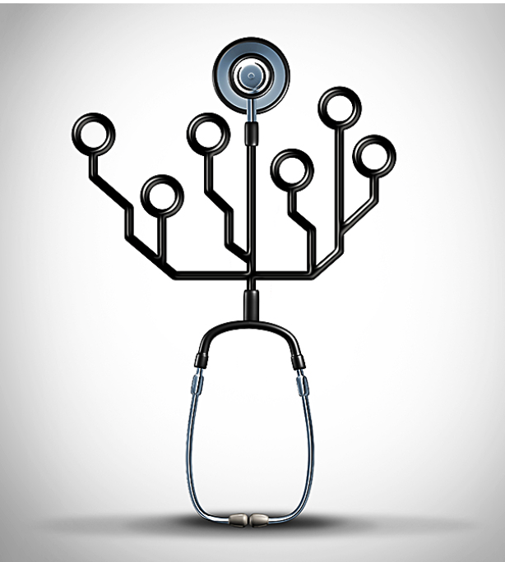
AI will not replace clinicians or researchers.
It may make them better.
Today, use but verify AI
LLMs can hallucinate and make things up. Sometimes the AI prediction is wrong. And, AI generates empathetic answers, generates physician notes in radiology, finds relevant medical research and information, and identifies lesions in images.
This year, conversational AI expands its use in exam rooms and LLMs expand in EHR notes, coding, and text generation. AI is actively speeding drug discovery.
In five years, AI will be common in assisting clinicians, researchers, patients and consumers. AI will be embedded in the EHR in generating text, providing research, finding patient similarity and patterns to assist in diagnosis and treatment.
ChatBots will be ubiquitous in answering consumer questions and in helping with our health at home.
wildpixel/Getty Images

